Slide 1
FALL/WINTER
PM1/PM2, EOC, FCLE & READING RETAKES
SCHOOL COORDINATOR
RETURN INSTRUCTIONS
Non-Test Materials

Slide 2
SUMMARY OF TEST SUBJECTS
FALL – PM1/Retake ADMINISTRATION
  High Schools
    PM1 (R)
    PM3 Retake
    BEST Algebra
    BEST Geometry
    EOC Biology 1
    EOC US History
    FCLE
FALL – PM1/Retake ADMINISTRATION
  Middle Schools
    PM1(R/M)
    Civics EOC Retake
    BEST Algebra
    BEST Geometry
Fall – PM1 Administration
  Elementary Schools
    PM1(R/M)

Slide 3
SUMMARY OF TEST SUBJECTS CON’T…..
WINTER – EOC ADMINISTRATION:
  High Schools/Middle Schools
    PM3 Retake (HS Only)
    BEST Algebra 1 EOC
    BEST Geometry EOC
    Biology 1 EOC
    US History EOC
    Civics EOC (MS Only)
All Schools – PM2
  High Schools PM2 (R)
  Middle Schools PM2 (R/M)
  Elementary PM2 (R/M)

Slide 4
ORGANIZATION OF MATERIALS
All schools/cost centers are going to receive a Security Box
  These are your 5 year materials
  Box contains manila folders with labels of what goes inside
    Test Agreements, Prohibited Activities, Training sign-in
    Chain of Custody (PBT Accom), Seating Charts
    Admin Record/Security Checklist, Security Log
All schools/cost center will also receive a District Coordinator Box
  These are your 6 month materials
  You may opt to keep your CBT log in tickets for all year use
Notes:
Small centers such as Jail, George Stone will receive an envelope with manila folders

Slide 5
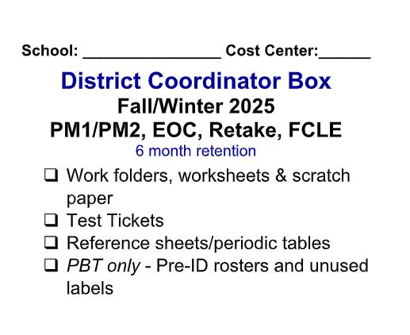
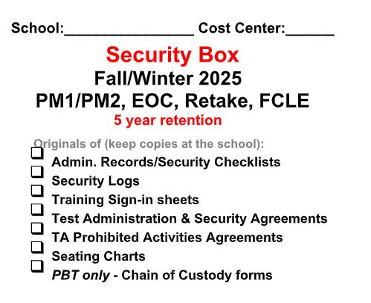
ORGANIZATION OF TEST MATERIALS CON’T….
Notes:
Revamped labels to be more concise

Slide 6
ORGANIZATION OF MATERIALS
You may organize by subject or teacher within the manila folder
DO NOT seal your boxes for turn in

Slide 7
Training/Agreement Folder
Will have 1 folder to cover BOTH PM1 and PM2
Folder tab will be blank
Place your training sign in at the top

Slide 8
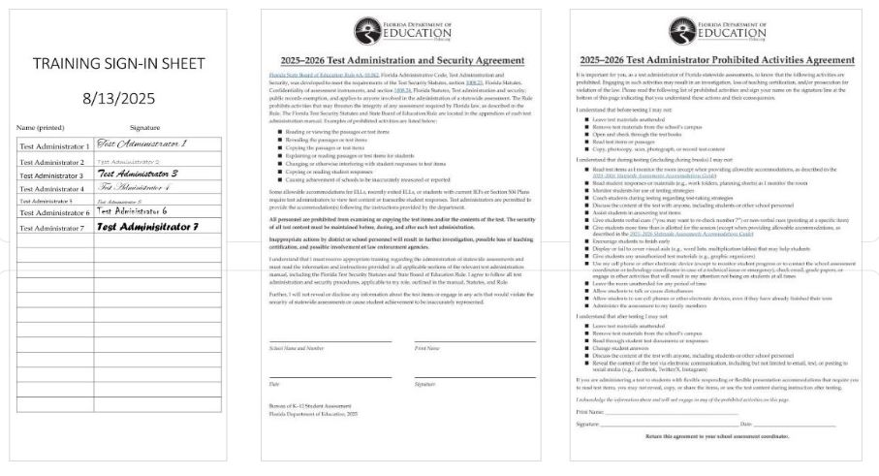

Slide 9
Admin Record/Security Checklist Folder
Will have 2 folders
  One labeled PM1 & Fall (MS/HS) OR PM1 (ES)
  One labeled PM2 & Winter (MS/HS) OR PM2 (ES)

Slide 10
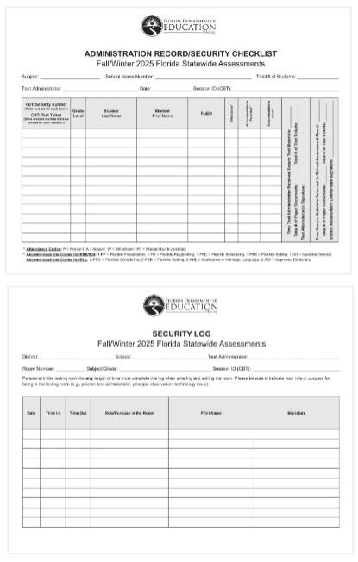

Slide 11
Seating Chart folder
Will have 2 folders
  One labeled PM1 & Fall (MS/HS) OR PM1 (ES)
  One labeled PM2 & Winter (MS/HS) OR PM2 (ES)
If you do not have Paper Based Accommodated tests, you will not have a Chain of Custody

Slide 12
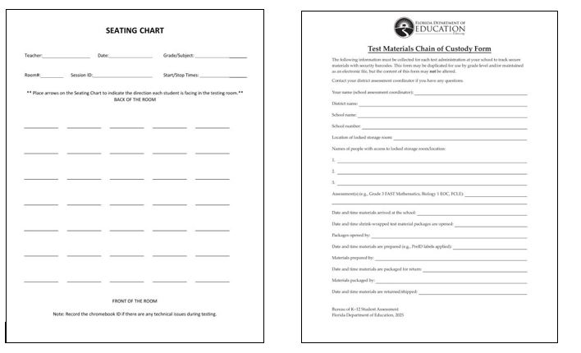

Slide 13
RETURNING TEST MATERIALS
MANUALS:
  Keep all copies of the scripts at your school for the Winter and PM2 administrations
  District Coordinator will advise when to dispose of – Typically once all the scores have been successfully reported

Slide 14
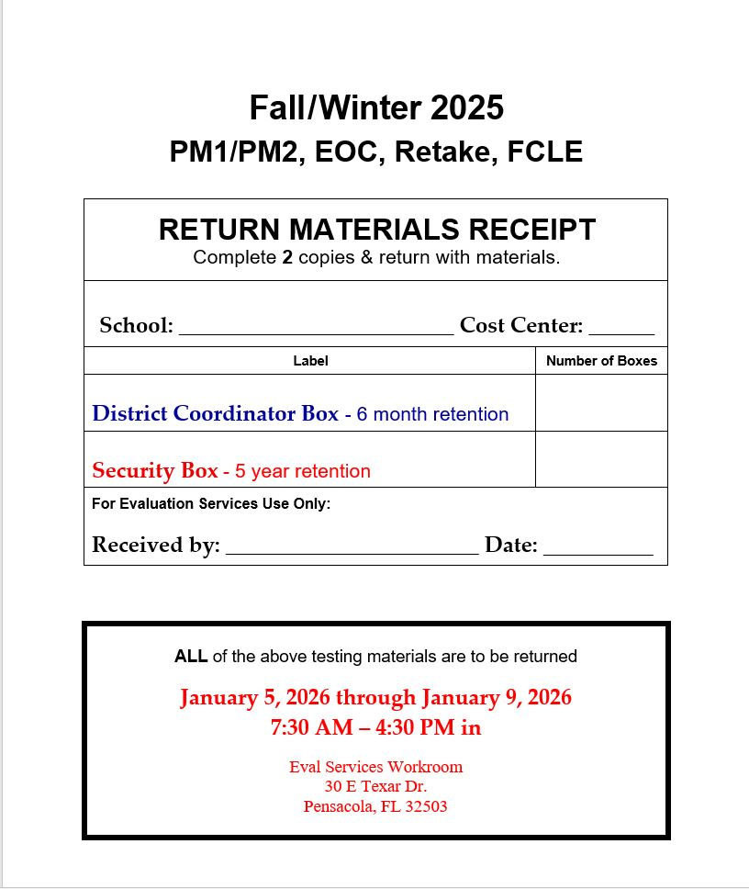
RETURNING TEST MATERIALS CON’T…..
RETURN RECEIPT:
Handed out today
DON’T LOSE ☺
Complete BOTH copies and return with testing materials
NLT: 1/5/2026 - 1/9/2026
Notes:
You are able to bring materials once ALL of your eligible students have tested. Please call to let us know when you will be here and if someone other than you is bringing your materials

Slide 15
QUESTIONS?
Heather Rykard, TSA hrykard@ecsdfl.us
850-469-5387/5386 (Main office)

